Slide 1

Youtube Trending video analysis

Slide 2



team
Regan Farris
Haris SUMRA
Jean Carlo cAmacho

Slide 3

Overview
YouTube (the world-famous video sharing website) maintains a list of the top trending videos on the platform. In order to determine the year’s top-trending videos, YouTube uses a combination of factors including measuring users interactions (number of views, likes and comments).
The dataset used is a compilation of daily records of the top trending YouTube videos.

Slide 4

What do you want to know?
Which categories are the most popular?
What trends do we see in other categories?
Is there a correlation that defines what makes these categories more successful than the others?

Slide 5
You Happy?
The extensive amount of data that was available enabled us to capture the answers we were seeking. We were able to see the top categories and also see how the time of the year made an impact on what was trending.

Slide 6
How’d you FIND it?
We were able to capture data from Kaggle.com. The dataset had information on trending videos per day for a 7 month window. In addition to this, the data included number of views, likes, dislikes, comments counters by category code. All these items helped us capture what we were looking for.

Slide 7
How’d You Fix IT?
Analyzed data to understand what information was not needed to answer main questions
Adjusted common fields to meet the needs of the analysis (e.g. Formatting dates, converting category code to a description instead of a number)

Slide 8
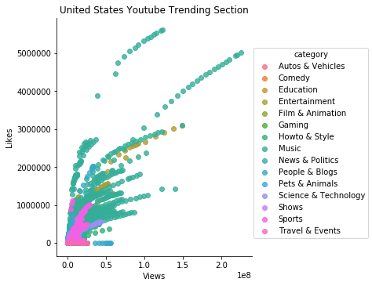
LIKES/VIEWS

Slide 9
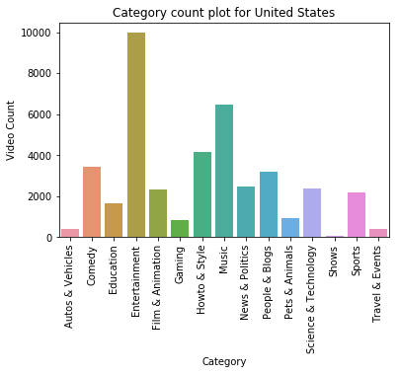
VIDEO COUNTS IN THE US

Slide 10
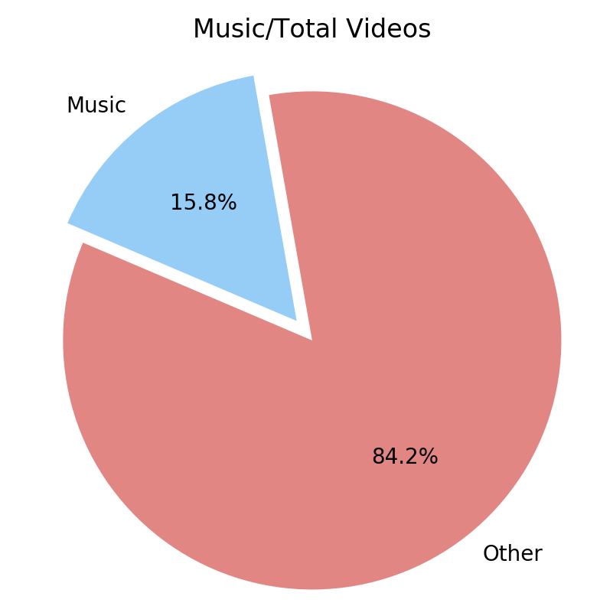
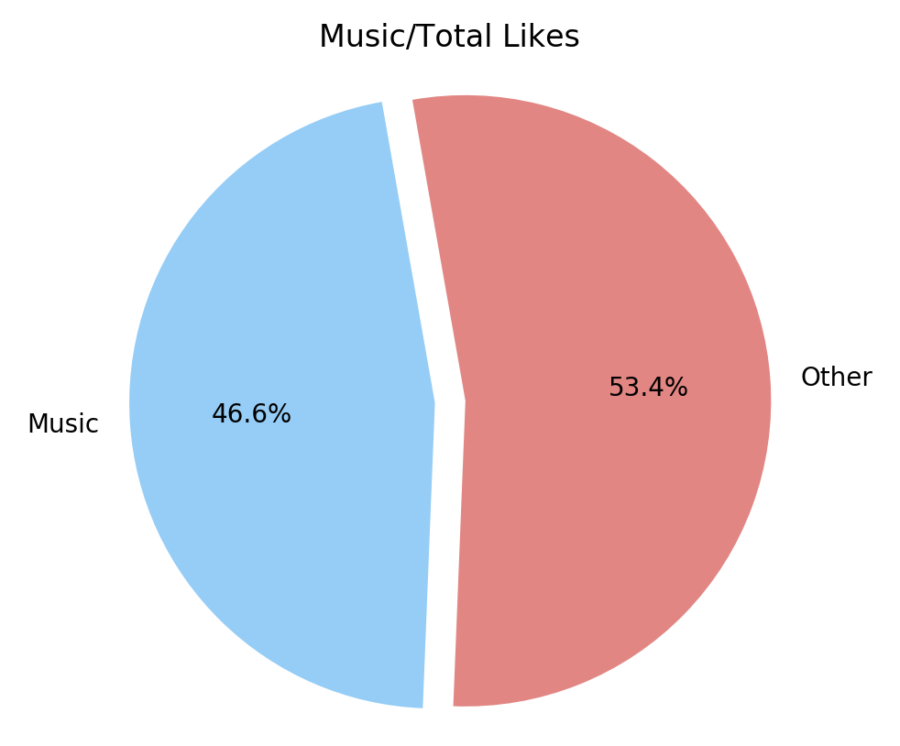
Music videos on Youtube
Music videos only represent 15.8% (6472) of the total videos (40,949) trending.
While only 15.8% music videos receive the most likes out of any other category at 46.6% of total overall.

Slide 11
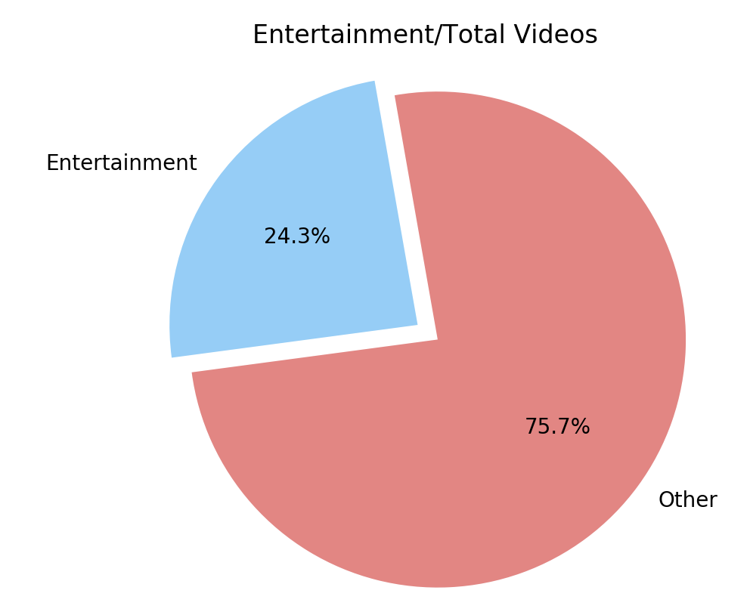
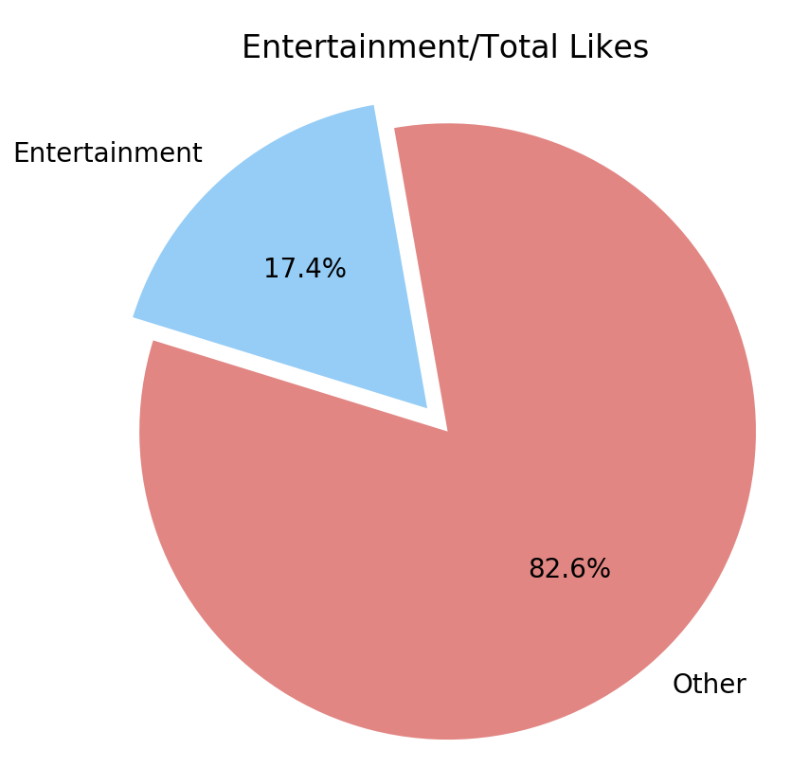
Entertainment videos on Youtube
Entertainment videos only represent 24.3% (9964) of the total videos (40,949) trending.
The entertainment category is 8.5% larger than the music category but receives significantly less likes, a difference of 29.2% (888,014,982) likes.

Slide 12
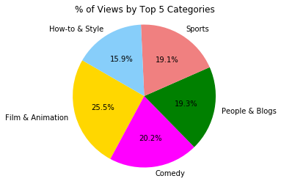
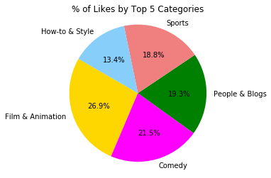
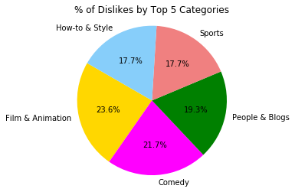
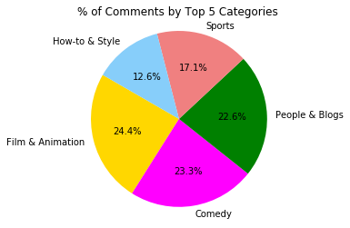
Aside from Music and Entertainment, what else is trending?

Slide 13
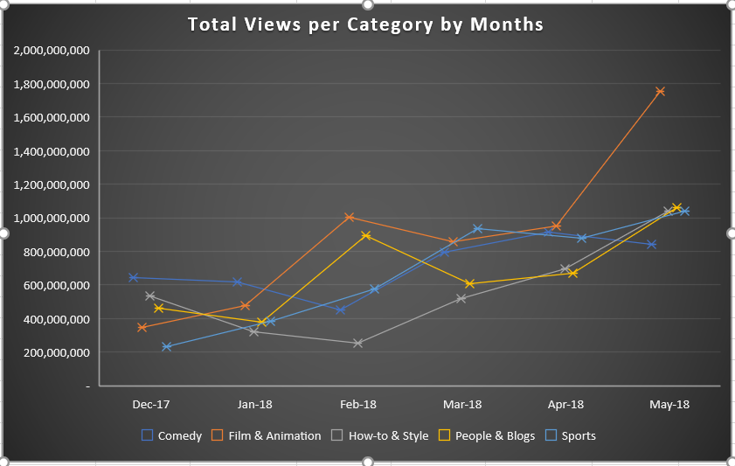
Additional insights

Slide 14

Thank you

